Slide 1

The Marketing Network
Monthly virtual meet-up
November 2023
In Partnership with

Slide 2
Agenda – simplifying
Prepping for 2024: Decode the evolving market and ecosystem
Go-to-Market Mastery: Helen Curtis unveils Go-to-Market strategies and introduces the new CIM-recognized training programs.
Spotlight Session: Sarah Duce from the Executive Network explains AI-Led Marketing. Sarah will demonstrate how AI can amplify your marketing efforts.
Live Case Studies: Live examples and discussions
Interactive Q&A

Slide 3
The Marketing Network
Our approach is built upon three pillars that will drive our success:
Enablement
Elevate marketing skills and expertise through collaborative thought leadership:
Knowledge sharing and collaboration
Comprehensive enablement programs
Proactively sharing insightful content
Certification/
Accreditation
Ensure skills to succeed in a dynamic marketing landscape:
Coterie Community CPD-certified modules
Comprehensive training on how to effectively market with ecosystem partners.
Certification and accreditation programs
Leadership Community
Connecting individuals, fostering peer relationships, and building a supportive network:
Facilitating buddy relationships
Quarterly meet-ups and monthly virtual gatherings
LinkedIn group as an ongoing digital hub
Igniting Success: Partners Powered by Marketing Excellence

Slide 4
Prepping for 2024
Poll Question 1: Marketing Plan Creation for 2024
Have you started creating your marketing plan for 2024?
Yes, it's in progress.
No, I haven't started yet.
The plan is completed.

Slide 5
Prepping for 2024
Poll Question 2: Stage of Progress
Which stage are you currently at in your marketing plan for 2024?
Initial planning
Mid-way through the process
Finalizing the plan

Slide 6
Prepping for 2024
Poll Question 3: Challenges in Marketing Plan Creation
What are your biggest challenges in creating the marketing plan for 2024? (Select all that apply)
Time constraints
Limited budget
Lack of innovative ideas
Meeting ROI targets

Slide 7
Prepping for 2024
Poll Question 4: Support Requirements
Where do you need the most help from Exclusive Networks and our vendor partners in your 2024 marketing plan?
Strategic planning
Financial support
Creative ideation
ROI optimization tools and analytics
Others (Please specify in the comments)

Slide 8
GTM planning

Slide 9
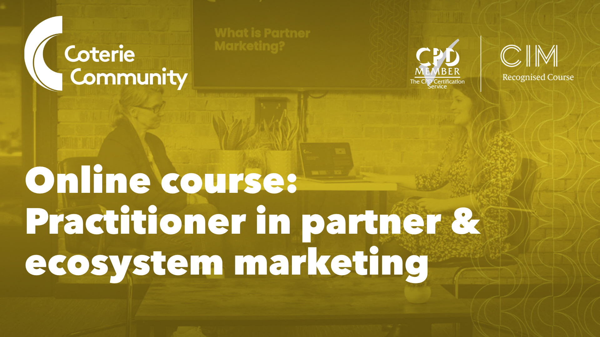

Slide 10



Firstly, what is a GTM plan?
A GTM Plan is action based and
takes a value proposition story to the end target audience you want to
reach via various tactics outlined in a plan to achieve specific objectives!
Not only that, making it customer centric will enhance the customer experience and help you gain a
competitive advantage.
Execution of the
GTM plan
Value proposition
GTM plan

Slide 11
GTM plan process and key sections
GTM plan core sections
Tactics: race framework
Activation
Objective
Reach
Execution
Target audience
Act
Measurement
Content and tactics planned for each market approach:
Engage the
target audience with the relevant messaging
Meet the objective
Challenges
‘Market to’, ‘Market through’ ‘Market with’
Or multiple?
Convert
Optimisation
Market fit
Engage
Competition
Sales enablement
Timeline

Slide 12
Planning made simple

Slide 13
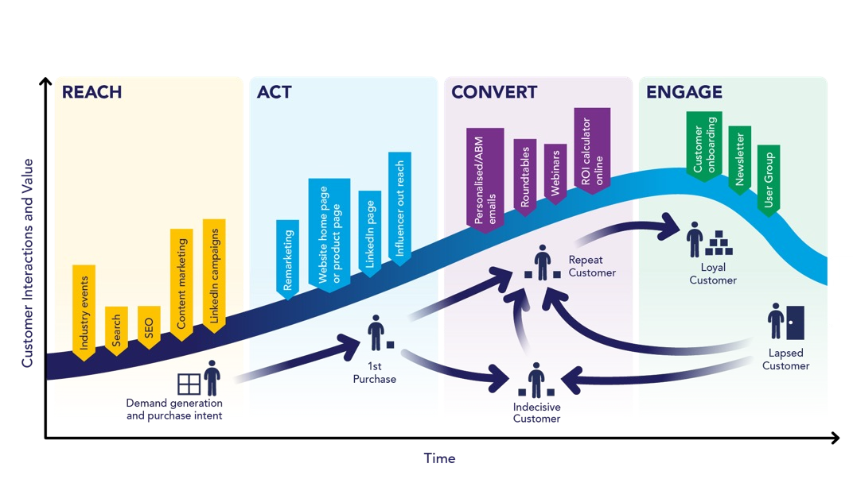
RACE framework
The RACE framework is a fantastic tool to help build a GTM plan that communicate with the target audience via various content formats and tactics, constantly engaging the target audience based on the customer lifecycle. (Similar to the sales funnel).
It consists of 4 steps designed to help engage throughout the customer lifecycle.
PLAN: The GTM development and strategy
REACH: Awareness/reach the target
audience
ACT: Interaction by the target audience
CONVERT: Activity to engage target audience, to convert to sale
ENGAGE: Continue to develop a long
term relationship once they are a customer/drive back into the business.
Source: Smart Insights

Slide 14
Checklist marketing:
to, through and with – tactic types
Partner marketing approach | PLAN Annual GTM and communications plans | REACH Grow awareness using inbound marketing | ACT Generate website leads using content assets | CONVERT Using offline sales touchpoints with online content support | ENGAGE Create loyalty amongst customers
GOVERNANCE SHARED Jobs-to-be-done Plans that are relevant to all segments | Go To Market plan Segmentation, Targeting Positioning – Value prop Sales training | Acquisition plans: Campaign plan Always-on demand generation plan | Lead generation: Content strategy Website landing pages | Prospect nurturing: Contact strategy Multichannel sales support | Retention plan Onboarding Customer care
MARKET TO (MUST DO) AUDIENCE: Reseller or distribution product owners | Focus on recruitment and enablement within the reseller and distributor Value proposition Statement and narratives of the value to the reseller or distributor | TOFU Tactics: Sales deck for the target buyer Blogs directed at specific influencers/buyers Infographics/videos to influence buyers Podcasts to influence partners Partner emails and events to recruit/educate Target keywords to help with partner recruitment Organic and paid media plan Partner Roadshows e.g., multisite events | MOFU Tactics: Partner Pages Products and solutions pages Campaign landing pages Welcome emails Case Studies | BOFU Tactics: Whitepapers TCO Calculators Free trial Retargeting ads Nurture emails | ROFU Tactics: Onboarding kit Customer support Evangelist training/funding Funded head On-ongoing training Roadmap/innovation workshops Online learning Roadshow Partner newsletter
MARKET THROUGH (RESELL) AUDIENCE: Resell model to a target segment (Value: distribution, commercial, marketing) | Build a value proposition to talk about the added value of the partner to the end enterprise (utilise content from the VP above) e.g. services, support, commercial | TOFU Tactics Partner portal content /campaign in a box Joint blogs directed at segments or resellers Publisher and trade-show emails and ads Target keywords for specific partners Sales enablement – webinar/virtual Podcasts for personas/segments | MOFU Tactics Landing page Ready-made campaigns Ad retargeting Influencer marketing Website live chat Persona based marketing e.g. technical and business Campaign page for end customers Event marketing – f2f or virtual | BOFU Tactics: TCO business-case whitepapers TCO Calculators Free trial Retargeting ads Nurture emails | ROFU Tactics: Customer support On-ongoing training Roadmap/innovation workshops
MARKET WITH (EMBED) AUDIENCE: Solution sell to end customer segments | Spin the above to talk about the joint value with the partner to the end enterprise and their customer. What does the solution look like and do for the customer? | TOFU Content: Joint content – TL/Blogs Organic/paid social LinkedIn social selling Email marketing Publisher and trade-show emails and ads | MOFU Tactics: Market through MOFU tactics + Segment and persona based Personalised Emails Tailored campaigns for solutions Utilise TL/body copy | BOFU Tactics: Case studies by application/industry References Nurture emails | ROFU Tactics: Customer support On-ongoing training Industry forums Roadmap/innovation workshops
MARKET TO ENTERPRISE (EMBED) AUDIENCE: One specific customer | Spin the above to talk about the joint value with the partner to one specific end customer | TOFU Content: Joint papers/blogs directed at the end customer ABM advertising IP advertising LinkedIn social selling | MOFU Tactics: ABM Personalised Emails and tailored campaigns 1:1 events – hackathons, innovation workshops | BOFU Tactics: Case studies by application/industry Tailored case studies References Demonstration Nurture emails | ROFU Tactics: Customer support On-ongoing training Roadmap/innovation workshops Exec to exec meetings

Slide 15
Keeping on track…

Slide 16
How AI can amplify your marketing efforts.

Slide 17
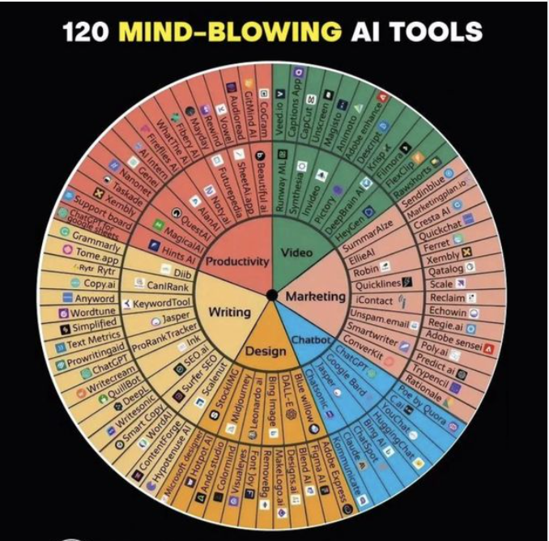
AI Explosion
This is just a snapshot taken in September of a FEW AI tools.
AI is overtaking the phrase “There’s an APP for that”
… it’s now
“There’s an AI tool for that”

Slide 18
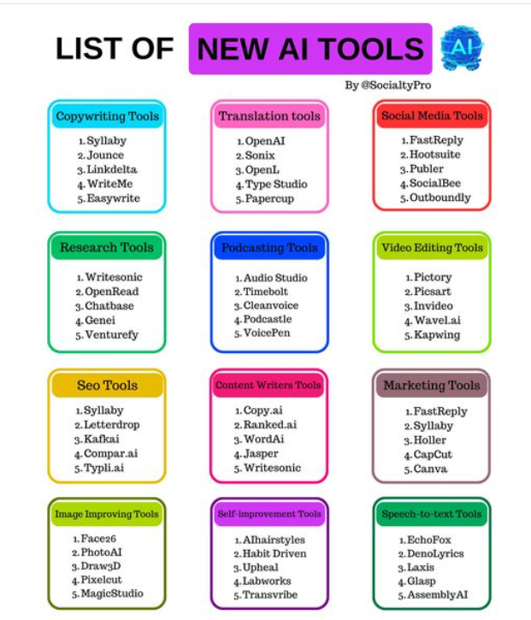
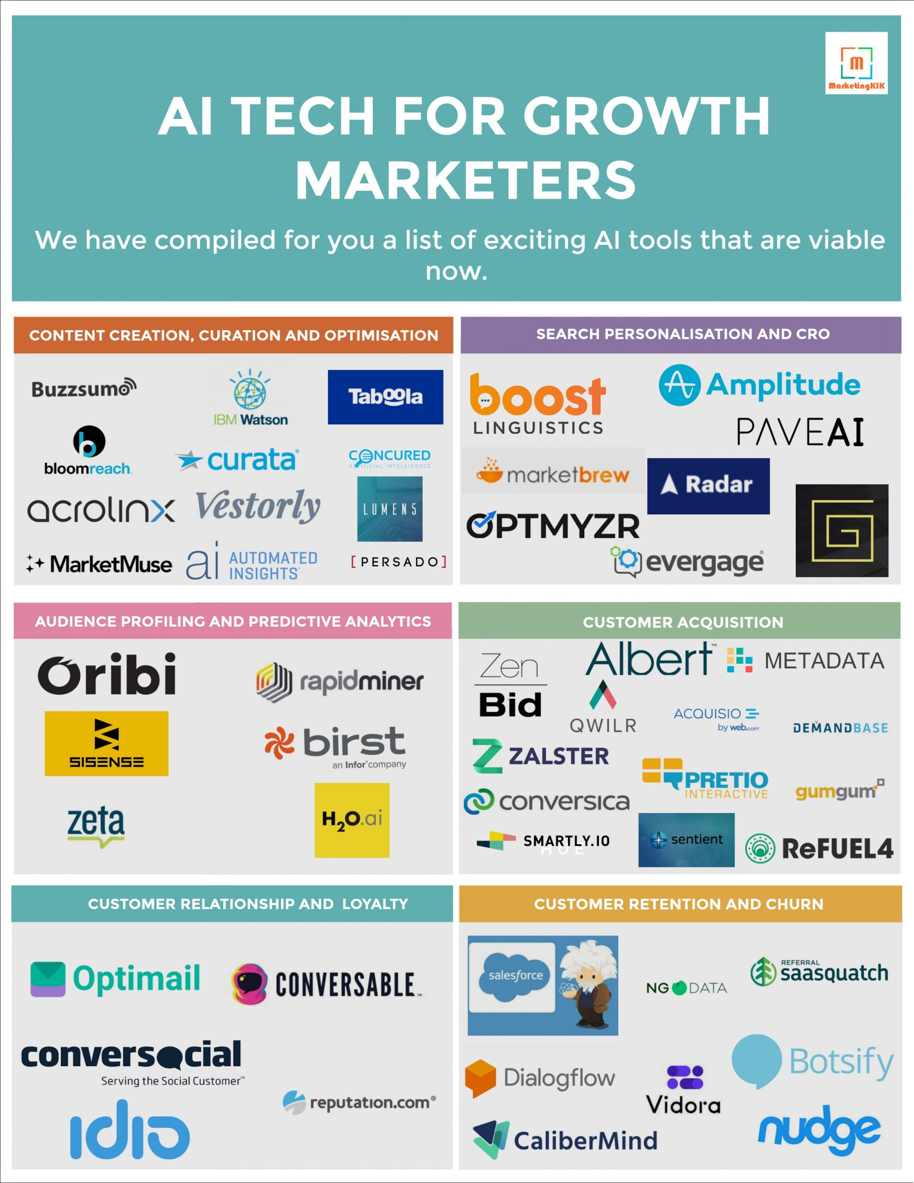

Slide 19



Why use AI?
BUYERS JOURNEY
57% percent of a buyer’s decision making process is made before they engage with sales
The role of marketing to create content that prospects can research and consume is FAR more important
CONTENT BENEFITS
Free useful content
Build brand reputation
Consultative approach
Become a trusted advisor
Raise visibility
Demonstrate expertise
Thought leadership
CONTENT CREATION
Use Staff Knowledge
Create customer stories
Reuse competitor content
Use Surveys
Adapt existing content
Research statistics
Use AI

Slide 20
3 Quick Tools to Try
Answer the Public
Chat GPT
Claude

Slide 21
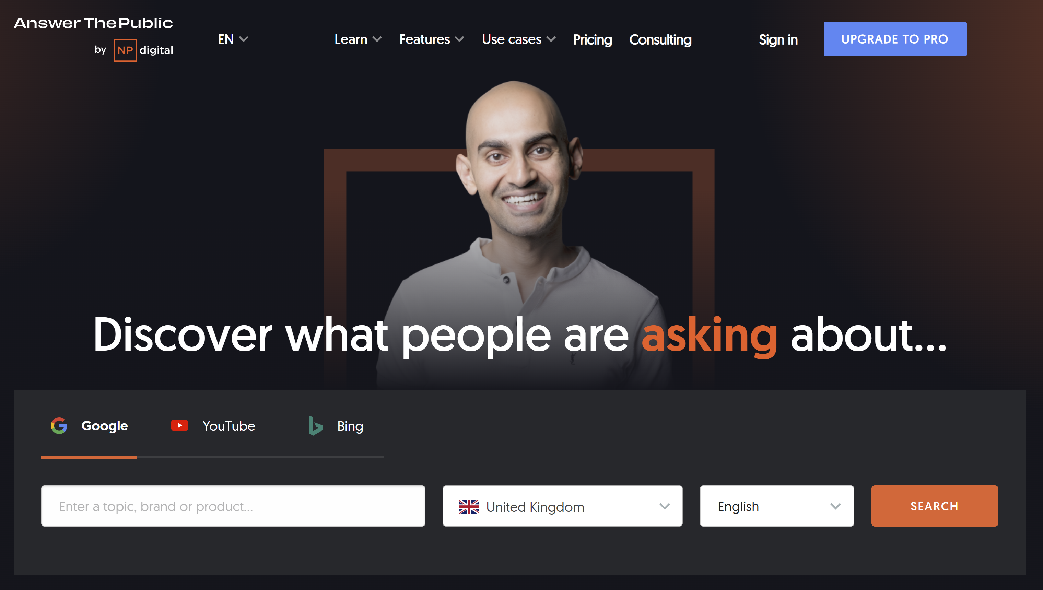
Answer The Public
Search listening tool for market, customer & content research.
Researching content for blogs & campaign content based off most searched for topics, areas of interest
https://answerthepublic.com/

Slide 22
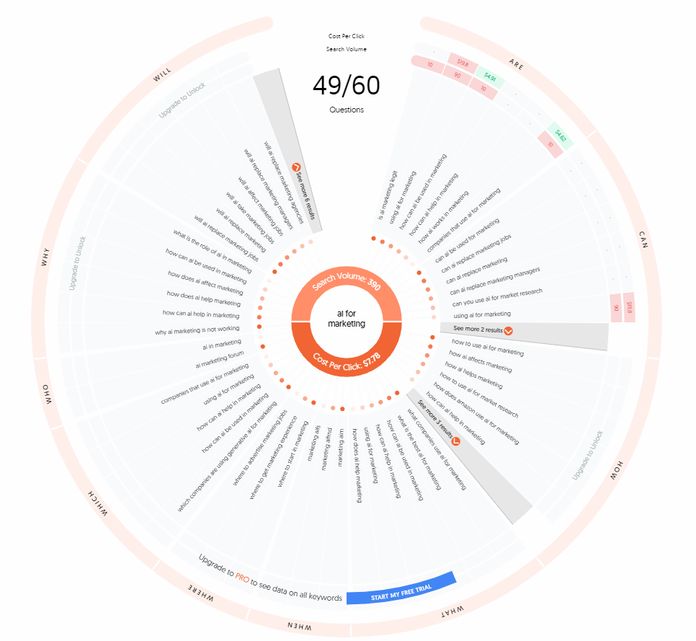
Answer The Public
I searched AI for marketing
This wheel shows the most commonly asked questions around this topic e.g.
HOW can ai be used in marketing
CAN ai be used for marketing
WILL ai replace marketing jobs?
WHO has an ai marketing forum
WHAT is the best ai for marketing
Etc.
Notes:
To be clear it doesn’t answer questions … it SHOWS you what people are asking around this topic so as well as being great for content ideation and creation by understand the questions people are asking, it’s also great for SEO/PPC etc and to see what people are saying about your BRAND!
The paid version allows you to monitor new ways that people talk & ask questions about your brand, product or topic.

Slide 23
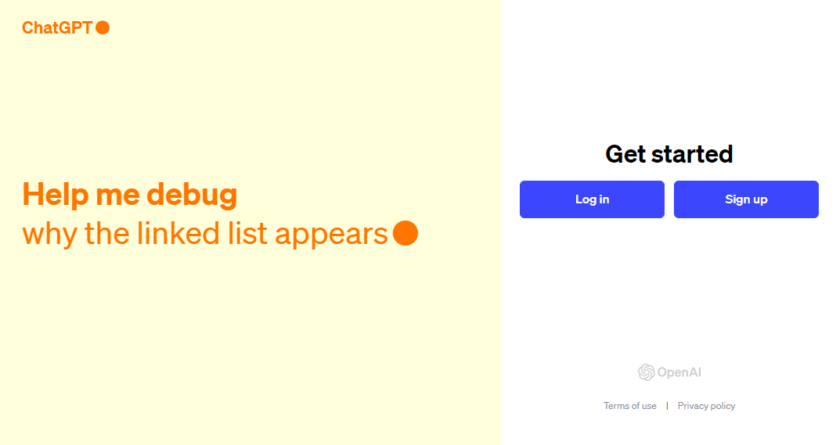
Chat GPT
Free-to-use AI system. Use for engaging conversations, gain insights, automate tasks, ask questions, create content, flip content etc etc.
https://chat.openai.com/

Slide 24
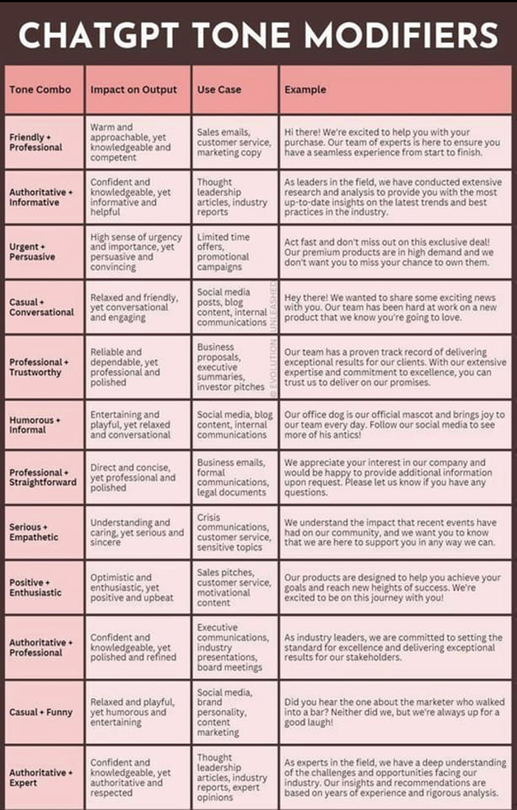
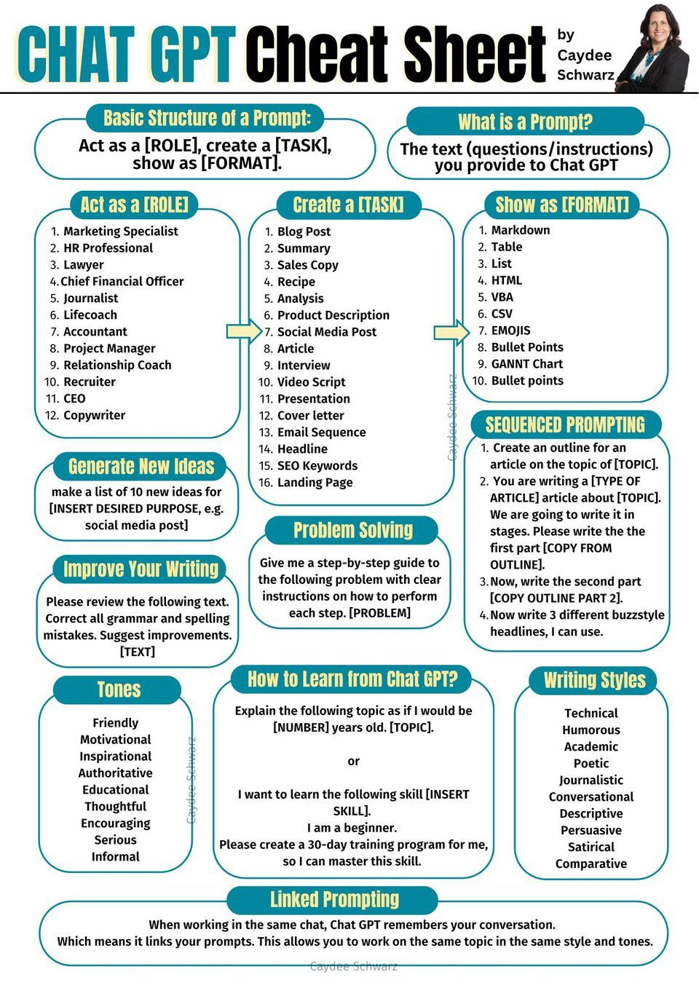

Slide 25
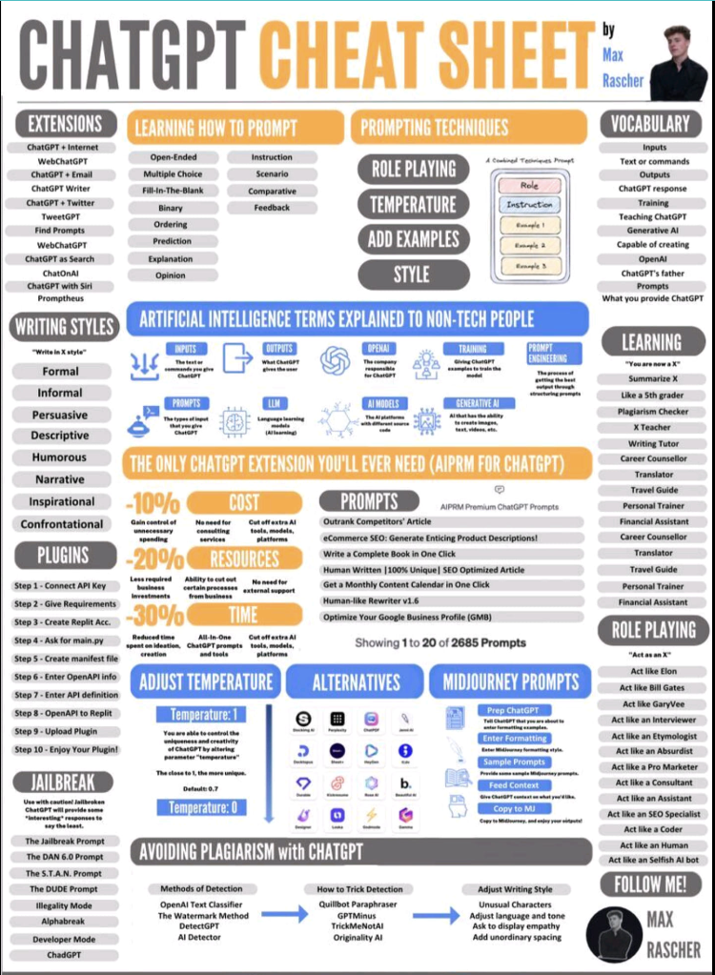
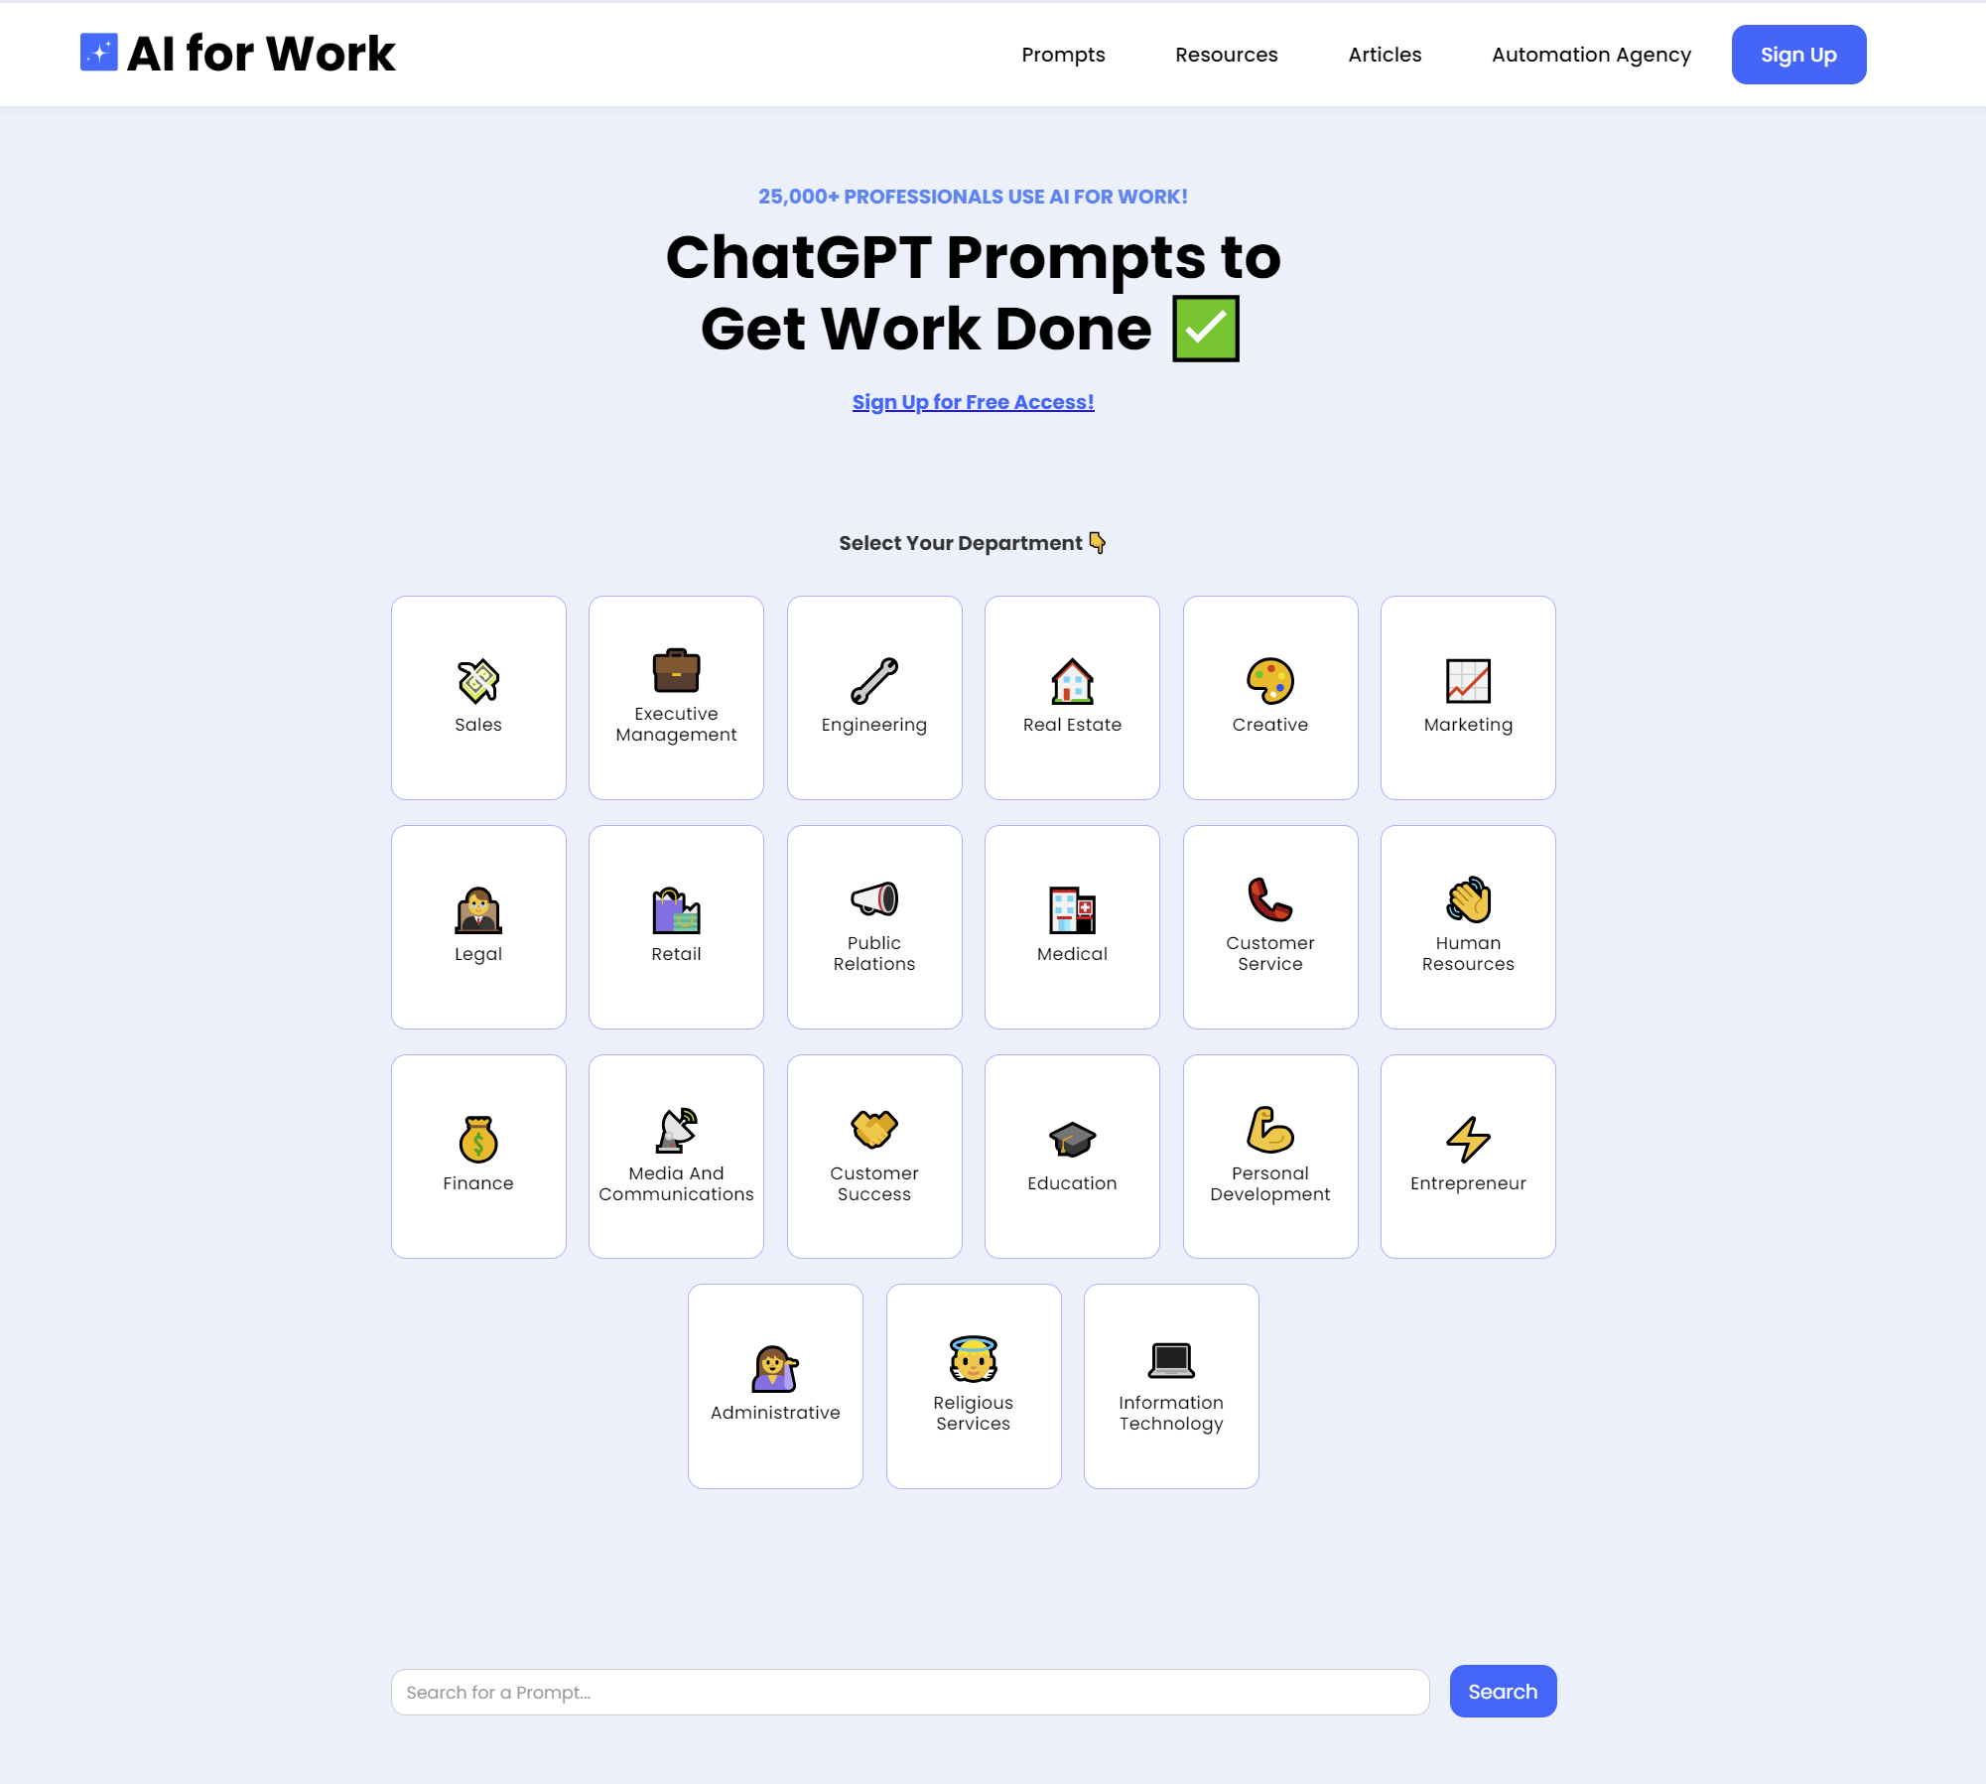

Slide 26
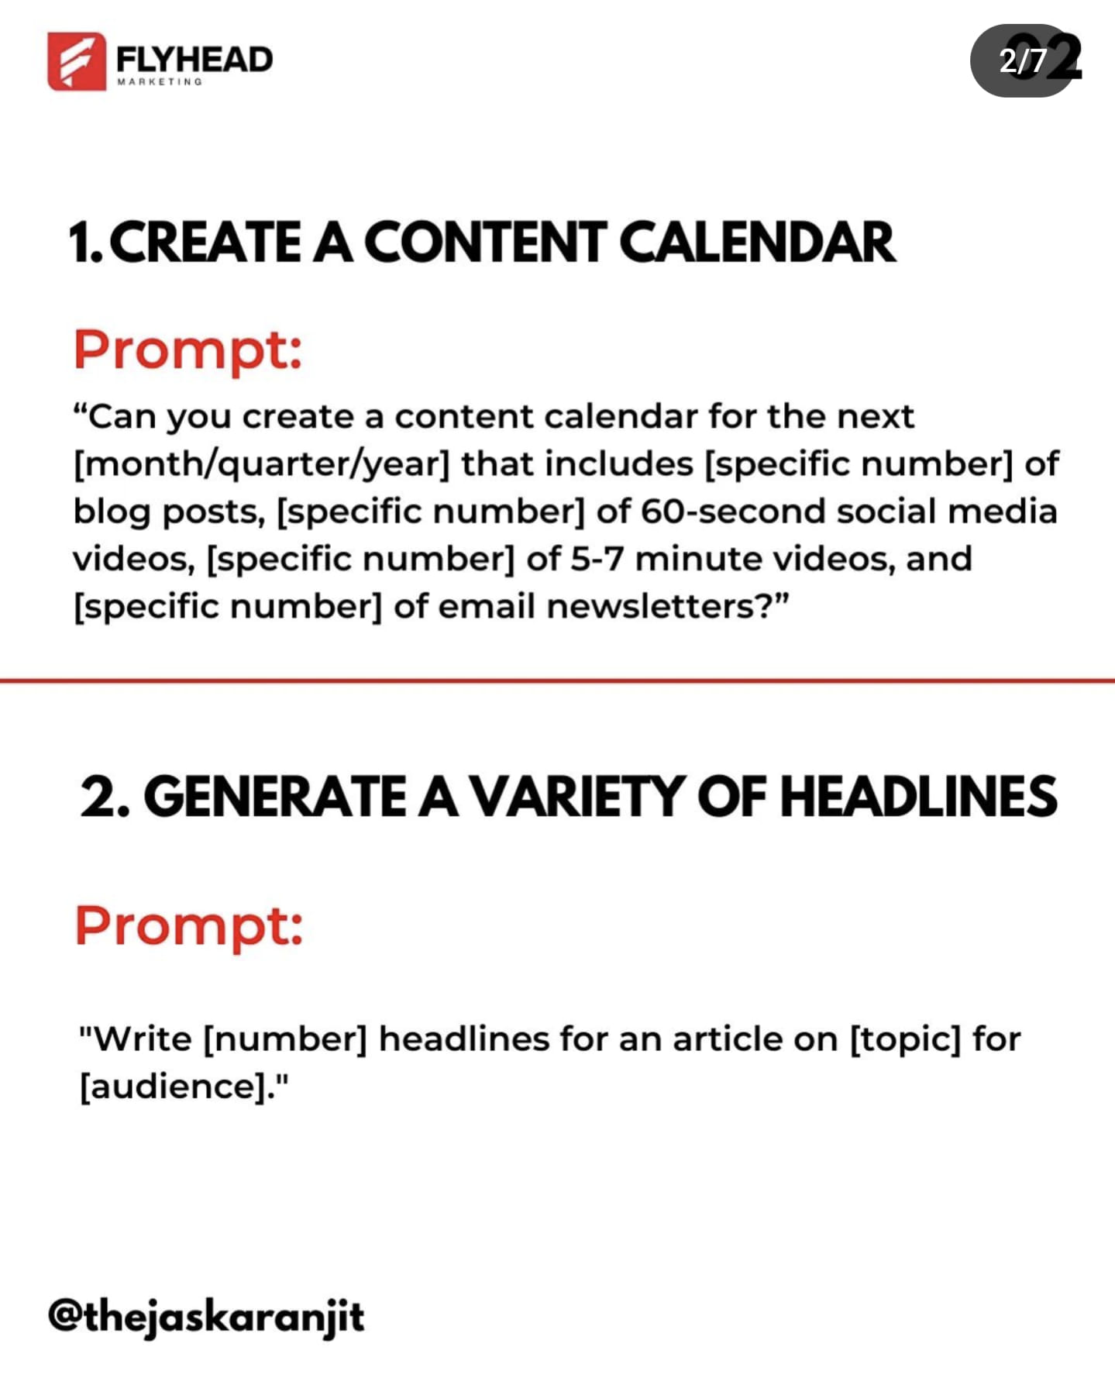
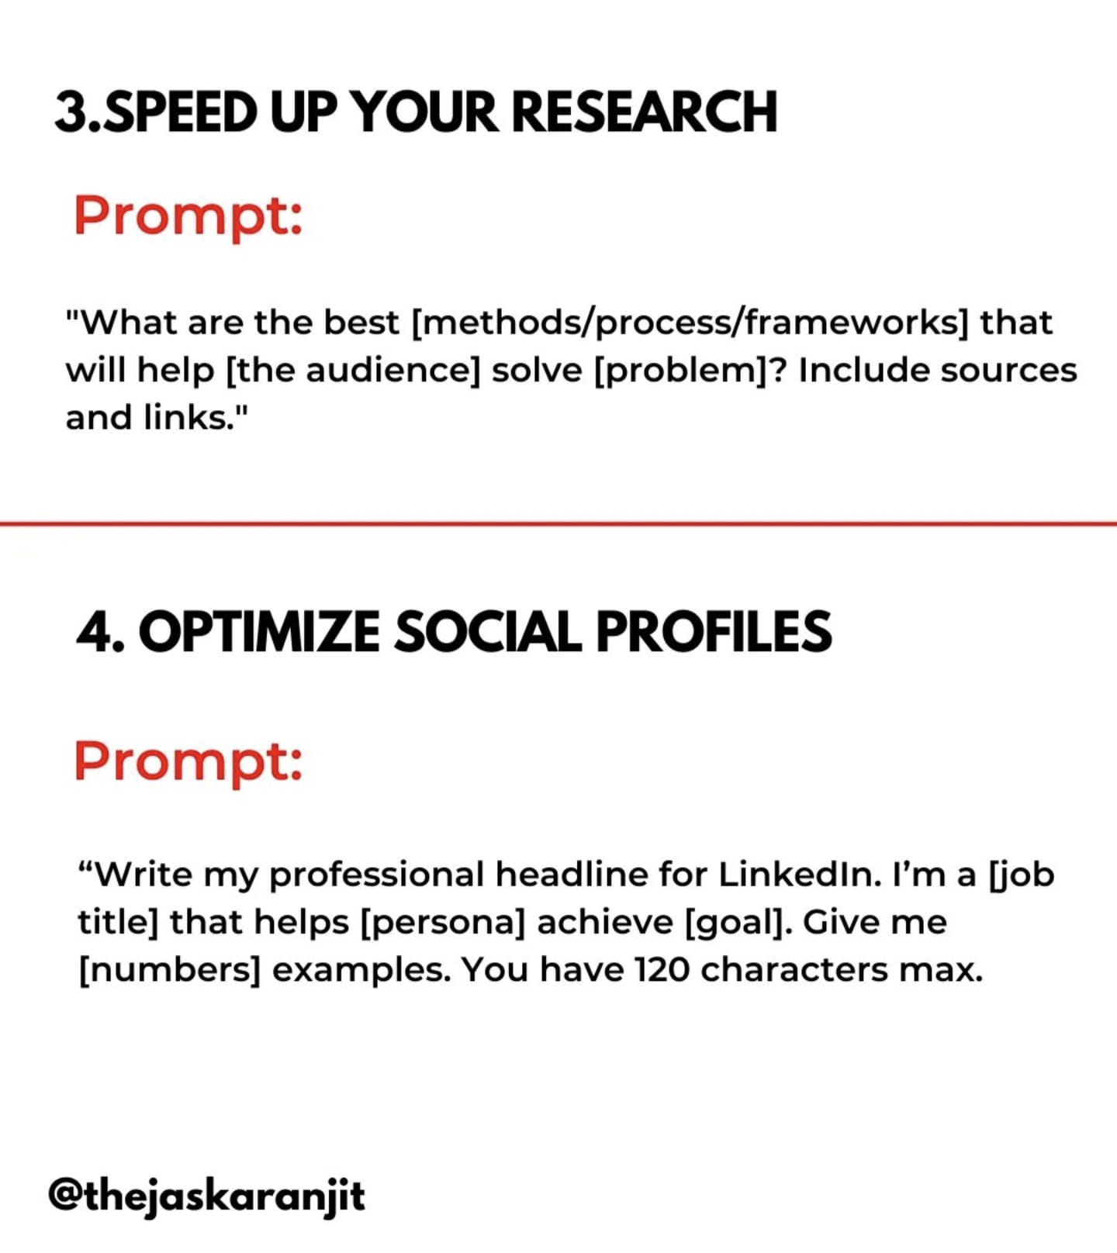
Chat GPT Prompt Examples

Slide 27
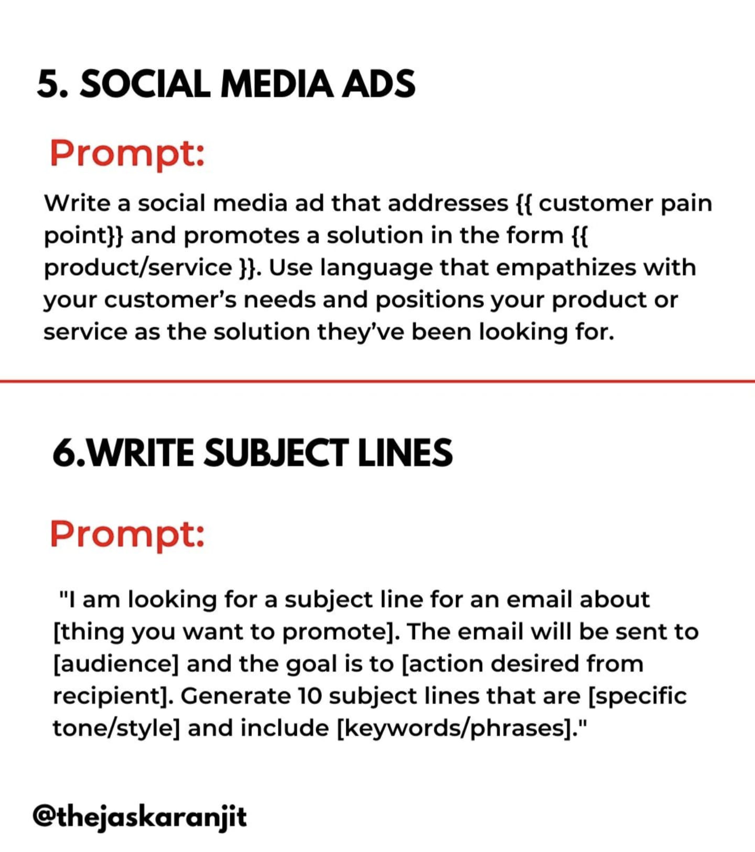
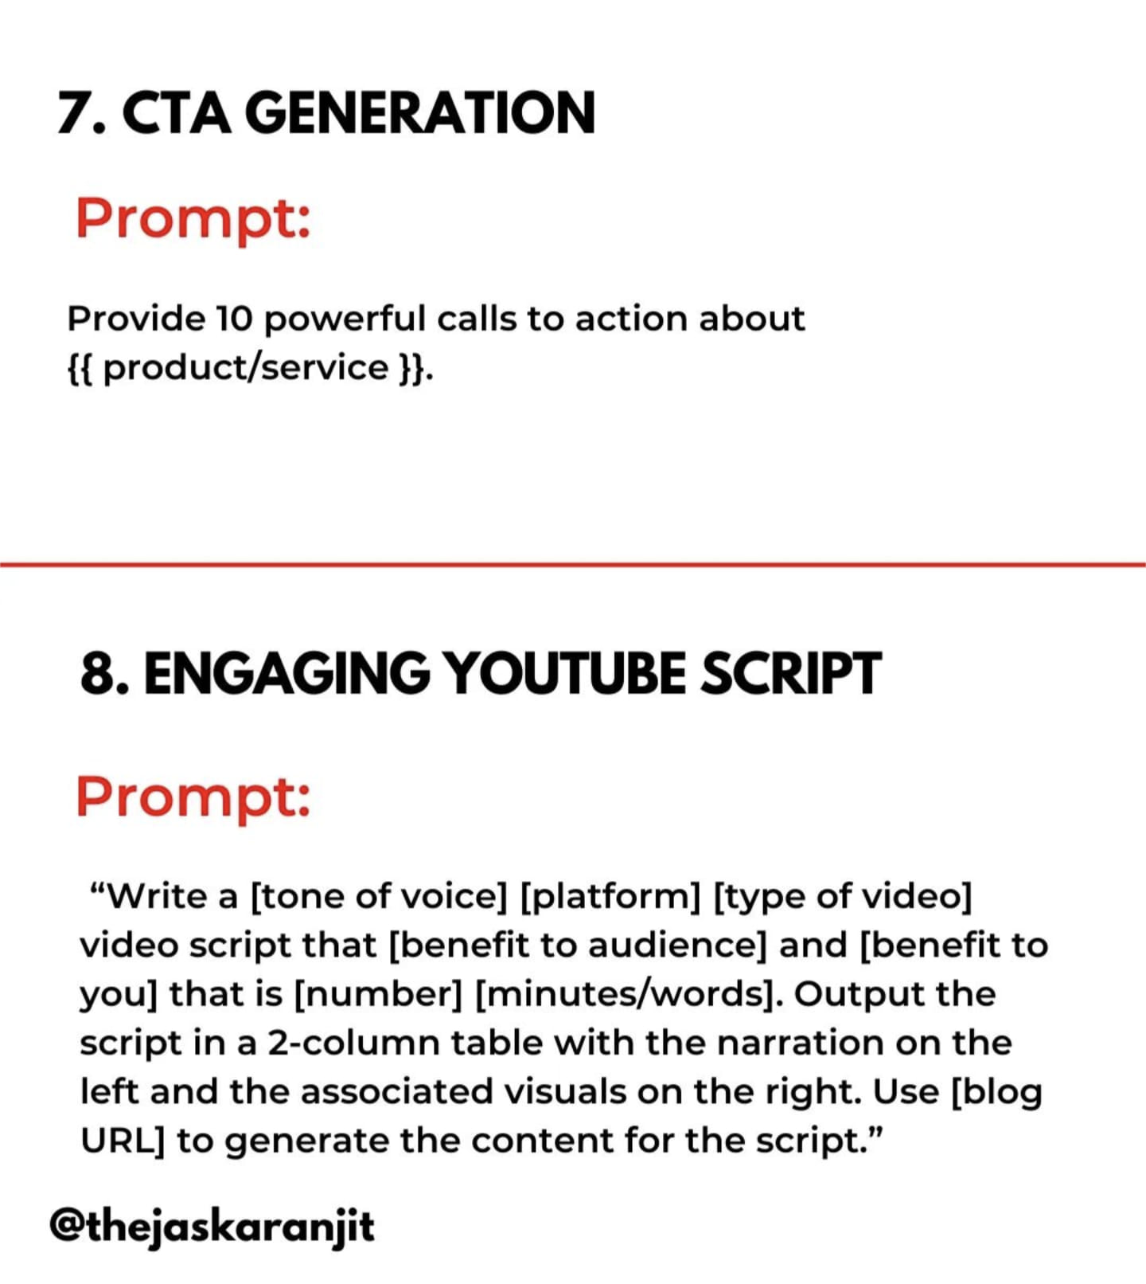
Chat GPT Prompt Examples

Slide 28
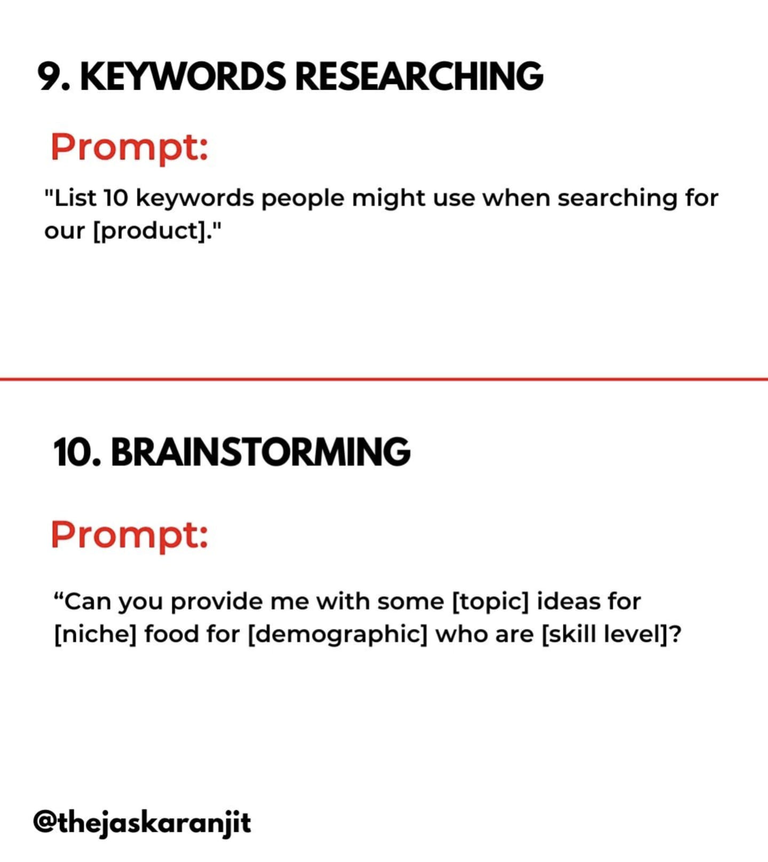
Chat GPT Prompt Examples

Slide 29
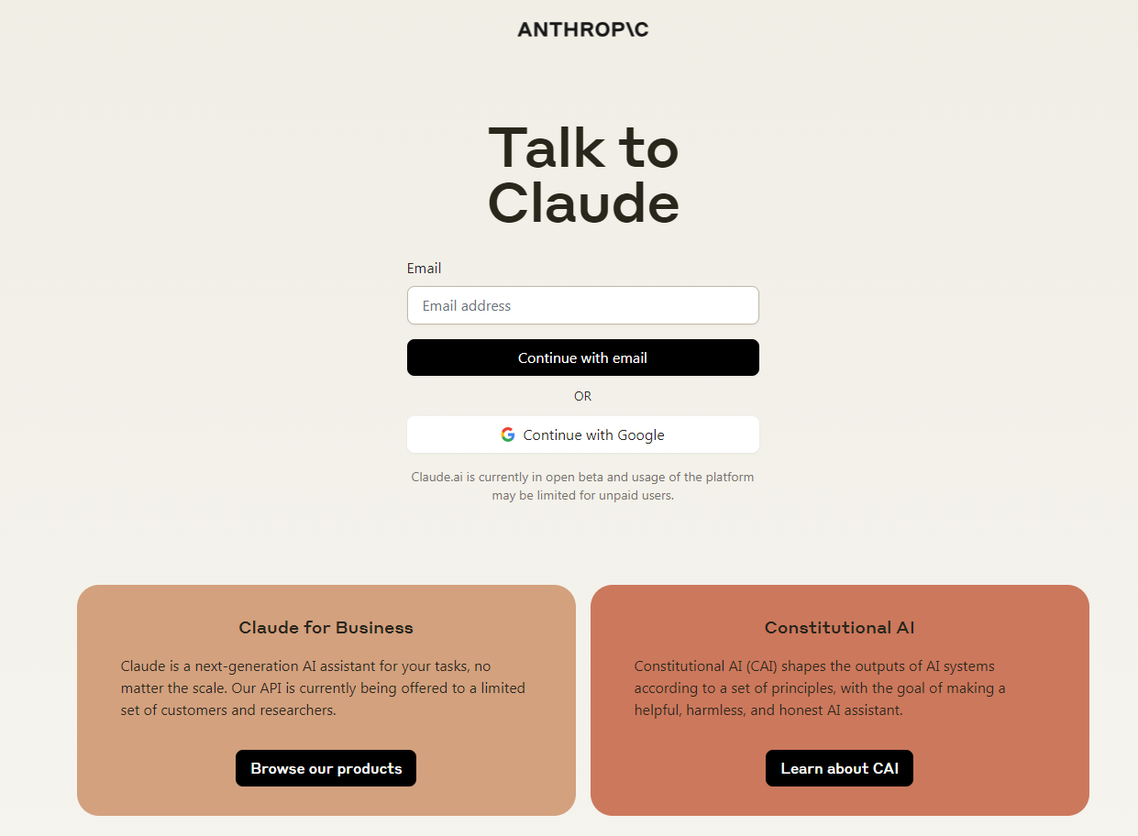
Claude AI
Both an AI chatbot and the name for the underlying Large Language Models (LLMs) that power it. Claude is trained to have natural, text-based conversations, and it excels in tasks like summarization, editing, Q&A, decision-making, code-writing, and more
https://claude.ai/
Notes:
Claude wins over ChatGPT on some benchmarks while losing on others. Free Claude is better than free ChatGPT, but ChatGPT has superior paid subscription with expanded knowledge and capabilities compared to Claude.
ChatGPT Plus is slightly more creative and Claude Pro is better at summarizing large amounts of text.
EVERYONE is using ChatGPT … less people using Claude.

Slide 30
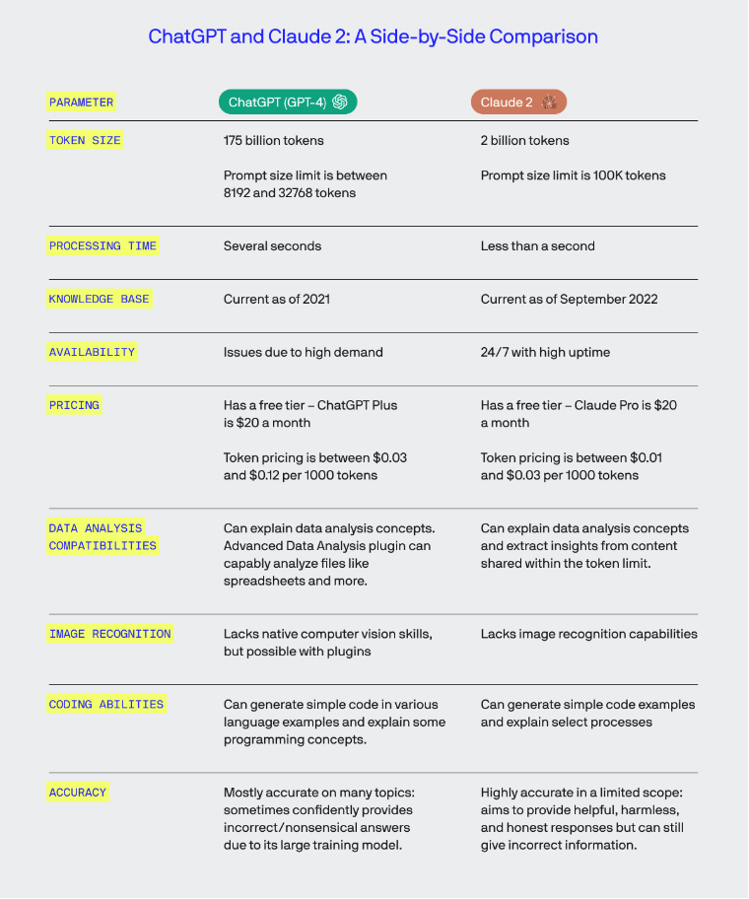
ChatGPT vs Claude
The Free Service for Claude is better
Claude has faster processing time
Claude has more current knowledge base
Claude better at summarising large
amounts of text
Claude’s focused conversational AI with
less risk
ChatGPT availability issues due to demand
ChatGPT mostly accurate, Claude highly accurate
Notes:
Claude wins over ChatGPT on some benchmarks while losing on others. Free Claude is better than free ChatGPT, but ChatGPT has superior paid subscription with expanded knowledge and capabilities compared to Claude.
ChatGPT Plus is slightly more creative and Claude Pro is better at summarizing large amounts of text.
ChatGPT pushes boundaries of knowledge and language mastery but requires ethical precautions at its scale. Claude is an example of focused conversational AI with less risk but also less upside in specialised domains
EVERYONE is using ChatGPT … less people using Claude.

Slide 31

Case Studies
1
2
3
4
New partner with no marketing resource who had access to large Facebook User Group
Immediate response to rebrief telemarketing supplier with change of direction & vertical
Flipping email copy from heavily product led copy to be more challenge or solution led
Batch cooking social media content from existing blog or email

Slide 32




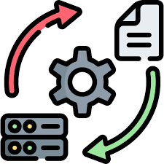
Strategies to introduce AI
RESEARCH A TOPIC
Elevate your Google searches. Try asking AI for information on a topic you’re interested in focusing on. It might just condense the information from multiple google sources into one place for you.
FIND IDEAS
You can use AI to suggest ways you can engage an audience on your topic of choice.
Ask it to suggest campaign ideas, ask it to suggest conversation topics … endless opportunities. Just don’t expect creative genius
DIFFERENT POVs
Use AI to pose questions for a number of different audiences.
First ask what challenges your target audience are facing, then ask what opening questions a sales person or telemarketer should try … etc
  CREATE DRAFT COPY
If you are genuinely stuck with creating copy, then try asking AI to make a start.
Think about your objective and what you’re trying to achieve. Keep trying different prompts until you get what you want.
FLIP CONTENT
Take product led or technical content and flip it to focus more on solutions.
You might need to first ask AI what are the key challenges of that audience & industry and combine those results with your technical draft

Slide 33
Q & A Session

Slide 34
November focuses on simplifying your marketing.

Slide 35
What are your hacks or commitments to simplifying your plan in 2024?

Slide 36
Some inspiration…
Focus on Key Objectives:
Narrow down your marketing objectives to the most critical ones. Having too many goals can dilute your efforts and impact.
Leverage Template Plans:
Use a pre-made marketing plan template to save time on formatting and organization.
Repurpose Content:
Take existing content and adapt it for different platforms or audiences instead of creating new content from scratch.
Automate Repetitive Tasks:
Use marketing automation tools for email campaigns, social media posting, and other repetitive tasks.
Prioritize High-Impact Channels:
Concentrate on channels that reach your target audience most effectively rather than trying to be everywhere.
Use Time-Saving Tools:
Utilize tools like Canva for quick graphic design or Hootsuite for social media management to streamline creative processes.
Set Up Collaborative Platforms:
Tools like Trello or Asana can help keep everyone on the same page and reduce the time spent on meetings and email updates.
Curate Instead of Create:
Share relevant content from industry influencers or like-minded businesses to engage your audience without always creating new content.
Outsource When Possible:
If budget allows, outsource specialized tasks like SEO or ad management to experts.
Implement Agile Marketing:
Adopt an agile approach, working in sprints, and adjusting your plan based on short-term performance metrics.
Simplify Measurement:
Use a small set of key performance indicators (KPIs) to measure your efforts rather than tracking every possible metric.
Use Social Media Wisely:
Instead of creating new posts daily, focus on engaging with your community and building relationships.
Batch Tasking:
Group similar tasks together and tackle them in one go to improve efficiency.
Content Calendar:
Plan your content in advance with a calendar to ensure a consistent posting schedule without last-minute rushes.
Quick Feedback Loops:
Regularly check in with your audience for feedback to quickly adapt your plan to their preferences.

Slide 37
The Marketing Network
Igniting Success: Partners Powered by Marketing Excellence

